Slide 1
RFVLSI Design Flow 2015 Upgrade Part-I RFSkill Programming Language: Design Cell Class/Placement
Yu-Jiu Wang
2015
(This is a quick internal documentation. Don’t follow this slides’ quality and format!)

Slide 2
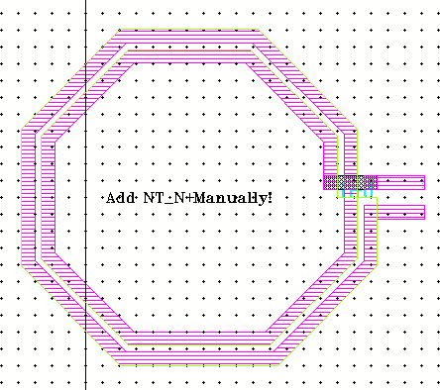
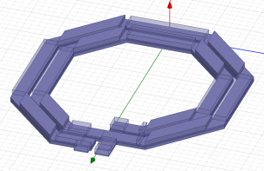

Current RFVLSI Design Flow
Initial Theoretic Ideas
$$S_{21}=\frac{s}{s+1}$$
Ideal Symbolic Circuit
Symbolic Circuit with Parasitics
Physical Layouts
Pcell Libraries
EM Simulations
Some are ready.
SPICE Equivalent Models
The blue part is already implemented in RFVLSI lab.
We cover green part in this slides.

Slide 3
Current Flow Integrates Two EM Sim Approaches
Write a program based on HFSS Vbscript, and SonnetLab matlab scripting to automate EM simulation.
Pro: design sweep, to find proper component dimensions.
Cons: we need to “manually” check whether the HFSS/Sonnet codes are consistent with the layout.
Use cadence gds-export, HFSS/Sonnet gds-import functions to build EM simulations.
Pro: always consistent with final layout.
Cons: It is inflexible. Lots of human interference. We can only passively verify whether our current layout functions? But not to do a few dimension sweep to choose best layout design.

Slide 4
Skill-to-EM translation?
RFVLSI lab has accumulated many layout pcell codes over the past two tapeouts.
During the two tapeouts, we find we bottlenecked at the layout-to-EM simulation step.
Idea, can we do this?
If possible, then we take advantages of our many layout codes, and seamly integrate them into many different EM simulation tools? (HFSS and Sonnet).
Skill-to-EM
Language
Translator
Sonnet
Simulation
HFSS Codes
PCell SKILL codes
Sonnet Codes
HFSS Simulation

Slide 5
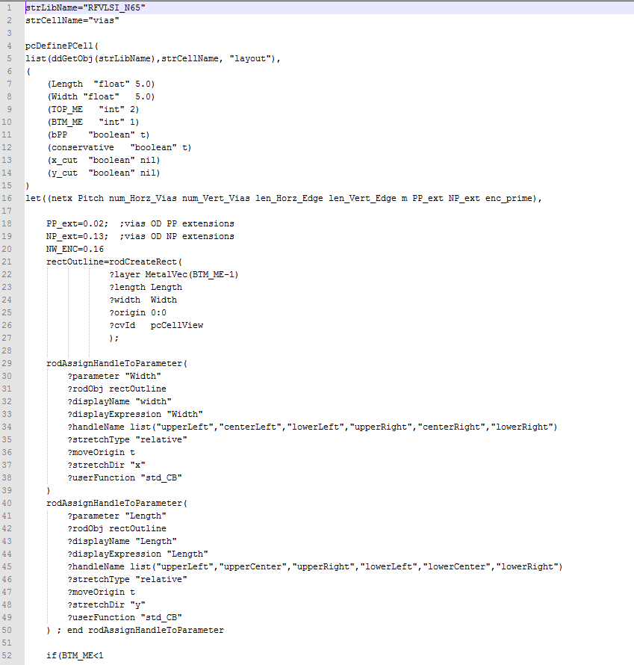
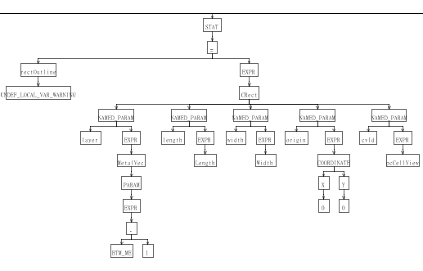
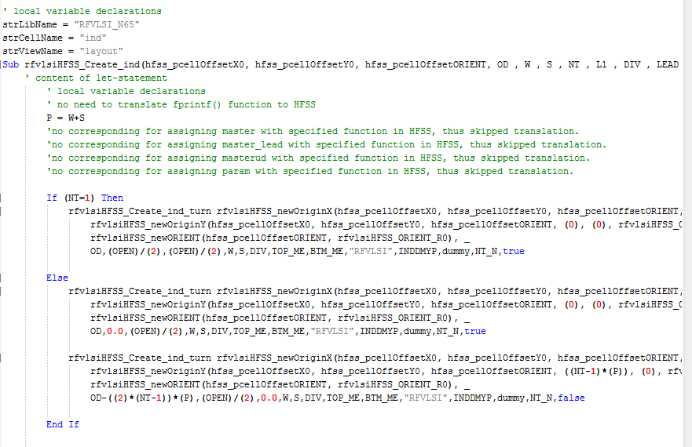
How a language translator works?
Note, SKILL, Vbscript and matlab has different language property. For example, the conditional operator is not supported in Vbscript: A?B:C, so the is no simple way to translate them.
However, if we limit our SKILL to an sufficient language subset, then we can do the translation with too much trivial overheads.
The translation process:
An Abstract Tree that represent the meaning of a SKILL code
SKILL-codes
HFSS or Sonnet Code

Slide 6
Current Architecture
Input file1 & 2:
MetalStack.csv
DielectricStack.csv
Process/EM String Template
Generator
skill_to_hfss
GUI
Input file3:
Some process depedent
Codes from N65.il (Will faded out in the future.)
Process.stg
(Internal only, and invisible to GUI users)
Input file4:
Process generic HFSS *.stg
Input file5:
HFSS.stg
(HFSS process independent template)
A Sim.vbs for a set of parameters ready for simulation
Input file6:
load(“pcell1.il”)
load(“pcell2.il”)
load(“pcell3.il”)
SKILL code files:
Pcell1.il
Pcell2.il
Pcell3.il

Slide 7
Drawbacks of current design flow
Synthesis/Schematic Design/Layout Design/EM/Model Fitting/Verification parts are not completely interconnected.
The underlying cadence Skill platform are not very safe:
Dynamic Scoping
Standard Turing machine computing model.
No object-oriented cell-level support which makes complex cell, such as power MOS layout very hard to debug.
No easy way for design reuse.
No unit-test(-like) support for large hierarchical design.
No useful analog design convex set formulation/optimization support.
No layout-to-readable codes to allow quick coding.
No modern IDE supports, etc.
No (N65/N40/N28/TN20..) process migration support.

Slide 8
There types of basic problems in Design
Pattern Match,
for example:
Verilog: And(net0, net1) ➔ RTL netlist: AND gate ➔ transistor-level netlist
2. Optimization problems
For example:
Opamp.Idc< 10mA
Opamp.Height=10um
Opamp.gain> 60dB.
Opamp.BW>1M
Opamp.Width.minimized()
3. Routing Problems
For example:
opamp1.output.connectTo(opAmp2.input)
There are many choices that can achieve the above goal.

Slide 9
Build an better underlying infrastructure, by redesigning the SKILL language
Safe and object-oriented physical design codes.
Layout/Schematic → high-level design codes .
Declarative testbench generation, that directly fitted into hierarchical design unit tests and measurement setups.
Cell-level design parameters-to-performance convex-set generation and optimization.
To create an better infrastructure, so a small team can deliver more productivity than bigger team through automation; and designers can focus their time on the essence of design, instead of implementation details.

Slide 10
Dynamic ➔ Lexical Scoping
Cadence SKILL(Dynamic Scoping)
X=1
dbCreateParamInst(nil evilvias 0:0 1
? SomeParameter 1)
dbCreateParamInst(nil vias 0:0 1
? SomeParameter X) // this X is 2.
------ the pcell definition
dbDefinePCell(
List(ggLib(“Lib”), “evilvias”, “layout”)
((SomeParameter 1))
X=2
)
New RFSkill (Lexical Scoping)
X=1
evilvias .place(0:0) with (
? SomeParameter 1)
vias.place(nil 0:0) with (
? SomeParameter X) // this X is always 1.
New compiler guarantee lexical scoping models.
New IDE checks for lexical scoping errors.

Slide 11
Turing model ➔ Evaluate & Substitute Model
Evaluate & Substitute
All variables can only assigned once.
A=A+1 is not allowed.
A=2, B=3, C=4
D=(C+(B*A)) will be evaluated internally:
D=(4+2*3)
D=4+6
D=10
Tree-type of execution model.
Turing Model
Sum=0
For(i 1 5
Sum=sum+1 )
What is sum???
We change the value of sum (which is stored in CPU register every iteration).
Very hard to debug; because the value of a variable depends on its context (the location of code).
Pretty bad when dynamic scoping is also used.
New IDE checks for the model problems.

Slide 12
PCell as a Class
pcell(
Lib.cell.view
(
(Param1 "1234")
(Param2 1234)
)
Master is lib.vias.layout
Inst1=Master.place(0:0) with (
?width 1
?length 1
)
Master.place(2:0 1) use Inst1
) // parameter reuse
Master.place(inst.upperRight() 1) use Inst1
) // relative placement.
)
Pcell(Lib.vias.view
( (Width 0.5) (Length 0.5) ………
Handle procedure(upperLeft() 0:Length)
)
pcDefinePCell(
List(“Lib”, “Cell”, “View”)
(
(Param1 "1234")
(Param2 1234)
)
Master=dbOpenCellView(“lib”,”vias”,”layout”)
dbCreateParamInst(master 0:0 1
?width 1
?length 1
)
dbCreateParamInst(master 2:0 1
?width 1
?length 1
)
)

Slide 13
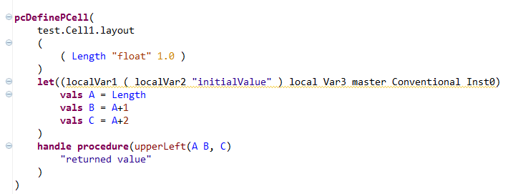
New Pcell Structure

Slide 14
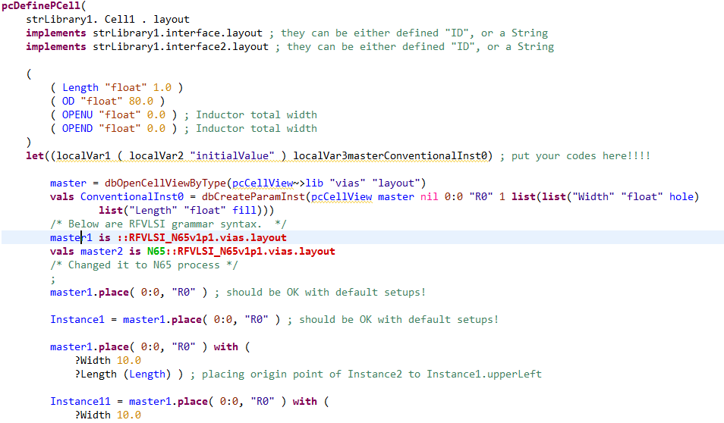
Placement Code
Refer to the right pcell.

Slide 15
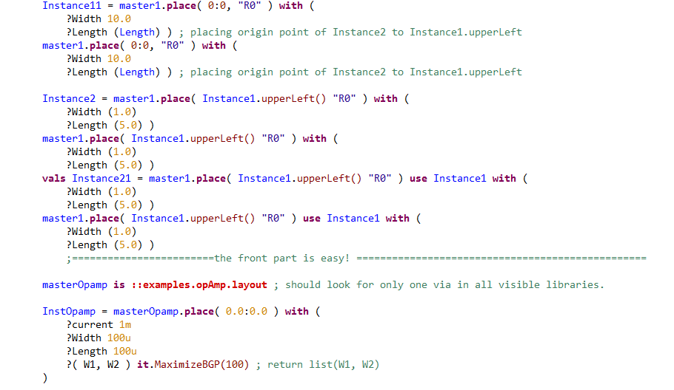

Slide 16
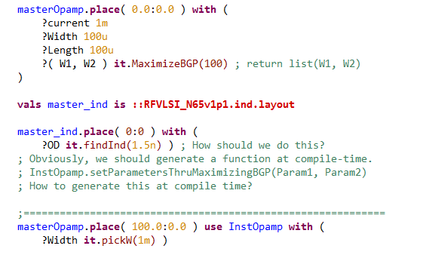
High-Level Code support
Will be linked with synthesis & verification & optimization flow soon.
LAYOUT ➔ High-Level Placement Code is under debugging.

Slide 17
RFVLSI IDE First Glimps
Support variable scoping checkings.
Support “evaluate-substitution” model checking.
Support syntax highlighting.
Support RFVLSI flow-integrations: (EM, cadence, calibre environment setup, circuit unit test…)
Pcell class function name checks. (parameter checks will be implemented later after flow is ready for better design safty.)

